Slide 1
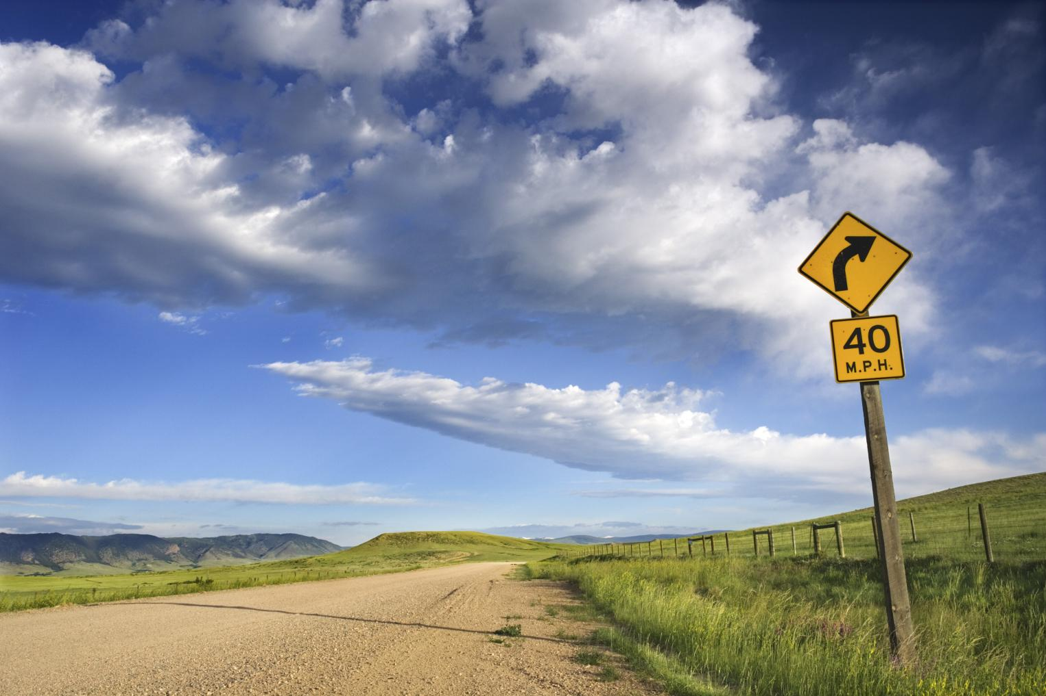

Montana Teen Driver
Education & Training
PARENT MEETING
Welcome!
Revised 2018
Notes:
Transition to Unsupervised Driving
In the early months of unsupervised driving, the majority of teens exhibit good driving habits however the study did find instances of texting behind the wheel, horseplay with passengers and running red lights.
While a very small number of instances of deliberate risk‐taking behavior were observed, the vast majority of “close calls” involved judgment errors that seemed to be indicative of inexperience and failure to anticipate changes in the traffic environment. A common scenario involved the teen braking hard after having initially failed to notice that traffic ahead was slowing or stopped.
Once teen drivers obtain their license to drive independently, the passenger make up shifts dramatically.
2011 AAA Foundation for Traffic Safety Report
Authors: Arthur Goodwin
Robert Foss
Natalie O’Brien
UNC Highway Safety Research Center

Slide 2
Driver Education
Parents/Guardians Meeting
Review traffic education schedule.
Requirements and expectations of the student driver and parents/ guardians.
Montana Graduated Driver Licensing (GDL) law:
  Requires six months minimum of 50 hours of supervised practice driving including 10 hours at night with a licensed parent/guardian or adult licensed driver authorized by the parent/guardian.
  Teen drivers need 2 hours of driving practice each week to meet the required 50 hours within six months. Learner licenses are valid for one year.
  Limits passengers and restricts night driving with first year solo license.
  No traffic tickets, alcohol or drug use.
  Everyone wears a seat belt at all times in the vehicle.
Notes:
Parent Meetings Required (10.13.307 ARM)
An approved traffic education program for young novice drivers must include a parent meeting at the beginning of the driver education class that covers:
course schedule, requirements, and expectations of the teen student and the parents/guardians;
information on Montana's graduated driver licensing (GDL) law;
best practices in GDL and parental involvement that includes:
managing their teen's graduated learning process through each stage of the GDL;
tips on supervising the driving practice during the initial permit phase;
tips to determine when their teen is ready for the next step in driving;
objectives for success and significant hazards associated with each driving phase;
and information and tools to negotiate and adopt a written agreement between the teen and parent that reflects the expectations of both, including clearly defined restrictions, privileges, rules, and consequences that serve as a basis for the teen to earn and for the parent to grant progressively broader driving privileges;
and any other information that the district considers important for the successful and safe completion of driver education.

Slide 3
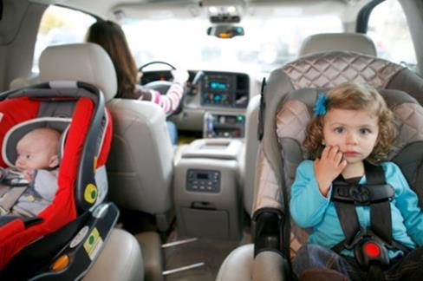
Kids are watching.
Be the driver you want your teen to be.
Always wear your seat belt and make sure everyone in the vehicle is buckled up.
Stay off your cell phone while driving.
Actively participate with your teen during driver education.
Calmly supervise teen driving and encourage safe driving habits.
Once your teen is licensed, set driving rules, limits and consequences.
Know Montana's Graduated Driver License Law: https://dojmt.gov/driving/driver-licensing/#graduated-driver-licensing

Slide 4
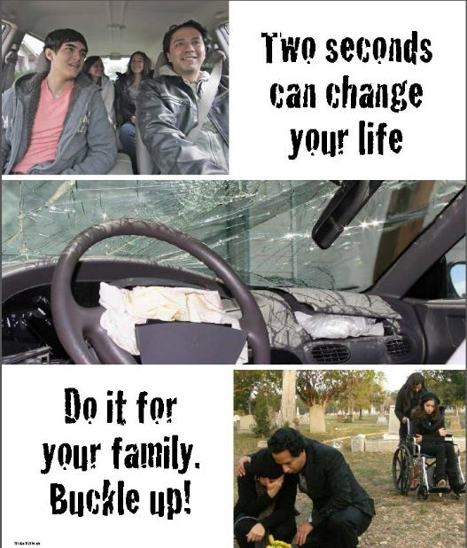
What are the risks facing teen drivers?
Lack of driving experience
Judgment
Speed
Distractions, including passengers
Fatigue, driving drowsy
Alcohol is involved in about 16% of fatal crashes involving 16- and 17-year-old drivers
These factors cause crashes, but what kills?
Not wearing a seat belt
Notes:
“A teen driver’s greatest lifetime chance of crashing occurs in the first 6 to 12 months after receiving a driver license.”
Lowest lifetime crash risk is during supervised learner period.
https://injury.research.chop.edu/traffic-injury-prevention/teen-driver-safety#.WgSzc8anGM8
Inexperienced Montana teens crash because they:
Have distracting passengers.
Drive too fast at curves and in poor weather conditions (ice, snow, fog).
Fail to see Line of Sight – Path of Travel (LOS-POT) far enough in advance.
Lose control of out-of-balance SUV or pickup truck that rolls.
Lack judgment.
Drive late at night.

Slide 5
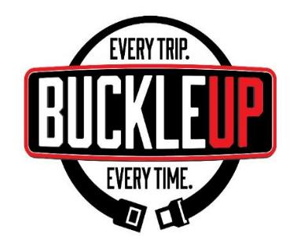

We All Need to Buckle Up
The sobering statistics …
On Montana roadways in 2015:
224 people died in crashes
118 deaths = not wearing seat belt
86 were ejected
200 of 248 of unbelted passengers suffered
fatal or serious injuries
111 of the 118 unrestrained people died in crashes on rural roads
Seventy percent (70%) of the time, when the driver is unbuckled,
children in the vehicle are also unbuckled.
Notes:
Montana Highway Traffic Safety Problem Identification FFY2017 http://www.mdt.mt.gov/publications/docs/brochures/safety/probid.pdf
On Montana roadways in 2015:
224 people died in crashes.
118 deaths are attributed to not wearing a seat belt.
86 were ejected.
200 of 248 of unbelted passengers suffered fatal or serious injuries.
111 of the 118 unrestrained people died in crashes on rural roads.
Seventy percent (70%) of the time, when the driver is unbuckled, children in the vehicle are also unbuckled.

Slide 6
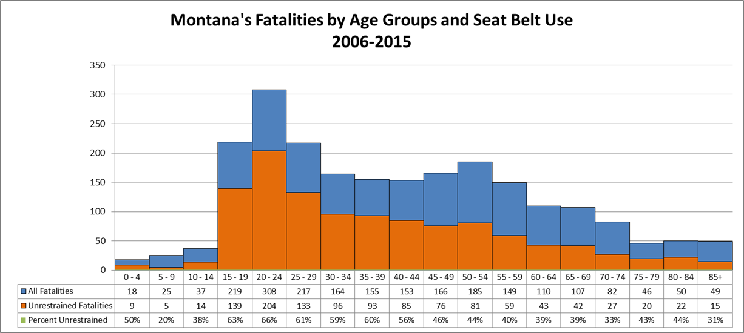
Teens & Young Adults at Risk
The deadly consequences of not buckling up
The orange section of the graphs shows how many people were not wearing seat belts and died in a crash.
Notes:
MDT Fatal Crash Data ten years 2006-2015

Slide 7
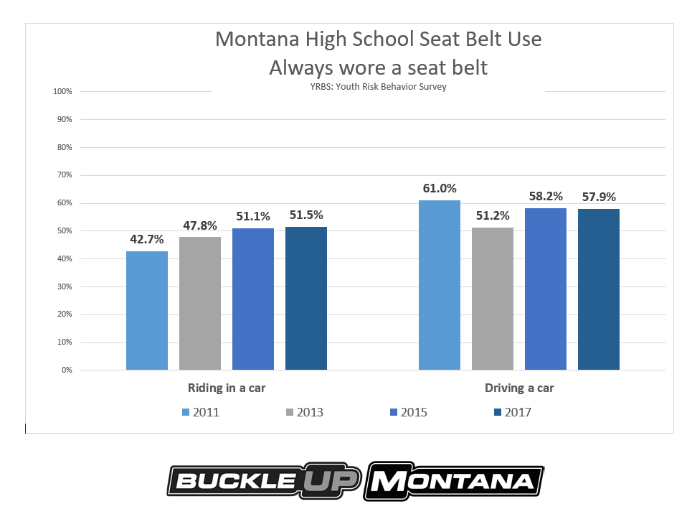
Notes:
Youth Risk Behavior Survey data – 2011, 2013, 2015,2017
Young Montana drivers and passengers who say they always wore a seat belt.

Slide 8

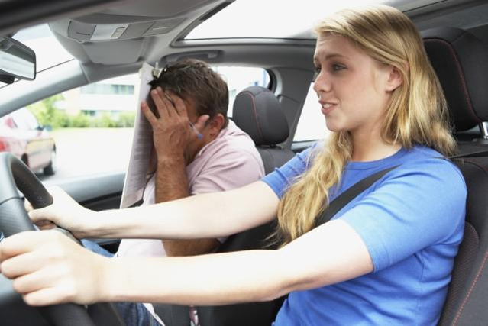
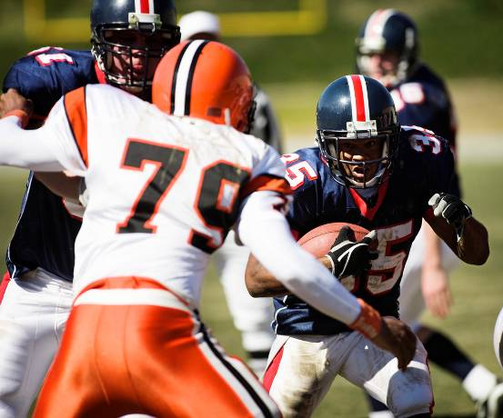
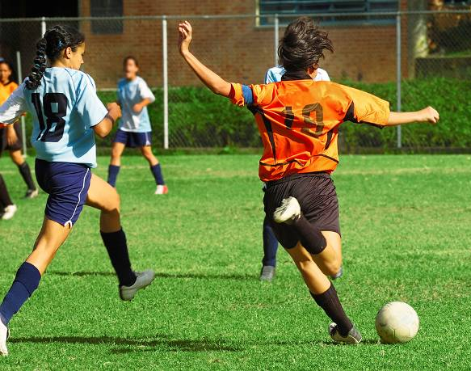
GDL Step 1: Guided Practice
6 -12 months • 50+ hours • 10 at night
Learn the rules of the road, then it’s time to practice, practice, practice.
Notes:
Guided practice is essential to skill development in sports and in the complex task of driving.
To build competence, novice drivers need a minimum of 50 hours of supervised practice driving under varied conditions before they get their license. Montana’s GDL also requires 10 hours of supervised practice at night.
Learner Licenses are valid for one year. Teens who need more practice can apply for another learner license at the driver exam station.

Slide 9
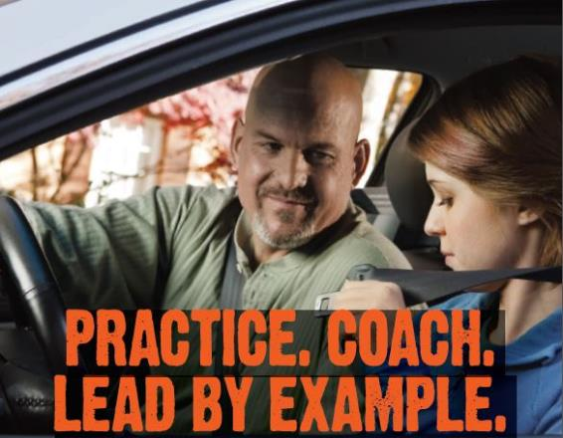
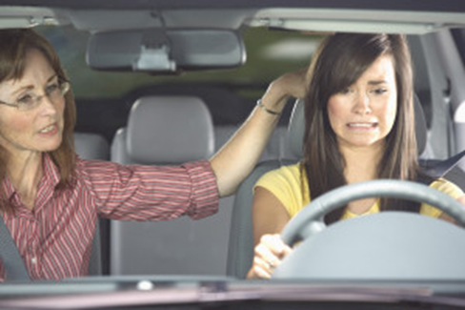
GDL Step 1:
Learner License
Pass the written test.
Drive with adult supervision: 50 hours (10 at night) for at least 6 months.
Keep a driving log.
No alcohol, drugs or traffic tickets.
Must wear a seat belt.
Notes:
Effective May 4, 2017 teens with a learner license can practice driving with parents, legal guardians and other adults authorized by the parent/guardian. Parents/guardians are still responsible for any loss or damage caused by the teen driver.
Even after they get their license teens will likely need more opportunities to practice in specific conditions with an adult, such as ice and snow, if they learned to drive in the summer.
Research supports a second stage of driver education after 6 months of practice. The Montana Highway Patrol (MHP) offers the Alive at 25 program and Montana DRIVE offers teen summer workshops – http://MontanaDRIVE.mt.gov.

Slide 10
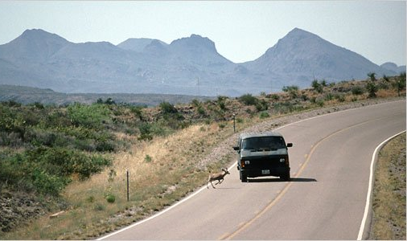
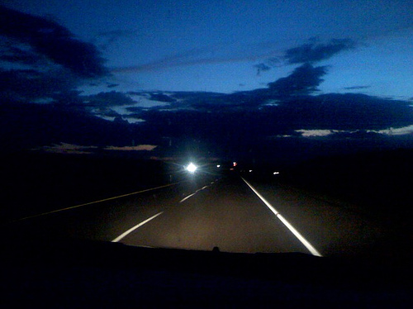
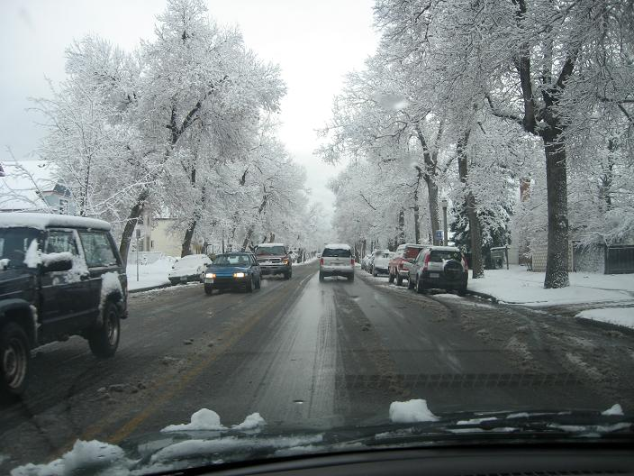
As your teen’s driving skills improve, practice driving in varied road and stormy weather conditions.
Notes:
Teen Driver Source
Understand parents' crucial role. Teens who say their parents set rules and are highly supportive (known as “Authoritative”), are half as likely to crash and less likely to drive intoxicated, speed, or use a cell phone while driving. They also are more likely to buckle up than teens with less involved parents.
Support greater parent involvement in the learning to drive process. Public policy needs to go beyond merely requiring 50 hours of parent supervised driving. According to a recent naturalistic study, parents know their teens need lots of practice during the learner phase but cannot articulate specifics. Parents typically cover vehicle handling and maneuvering skills under benign conditions (i.e., little to no traffic, nice weather) but do not teach skills such as scanning for hazards or regulating speed for driving conditions.
CHOP research shows these skill deficits lead to a significant portion of driver error-related teen crashes. Parents also need to have their teens practice in a variety of settings, including with commuter traffic, on rural and urban roads, and in inclement weather. Share the study with policymakers to advocate for greater parent involvement in the learning to drive process.

Slide 11
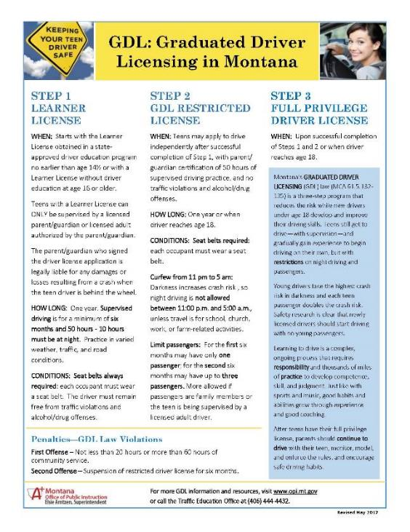
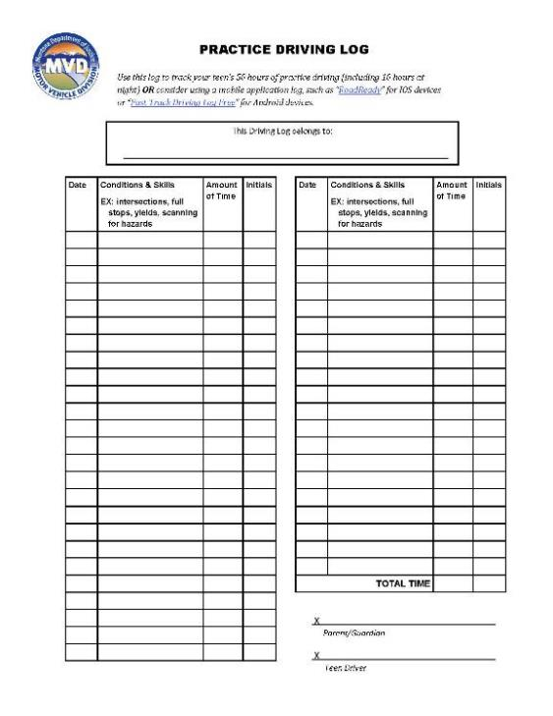
GDL Fact Sheet & Practice Driving Log
  Driver examiners will ask to view practice log when teens apply for their first-year restricted license.
Notes:
The Practice Driving Log replaced the original log book distributed by the Motor Vehicle Division/Department of Justice. The Traffic Education Office at the OPI developed a GDL Parent Factsheet to go with the new log sheet. Take this log into the car with you every time you drive together to log the required hours during Step 1 of the GDL.
GDL information
Techniques for guiding teen driver’s practice period
Log to track practice time
Parent/Teen contract
Bring to driver examiner when applying for restricted license; they will ask for it.

Slide 12
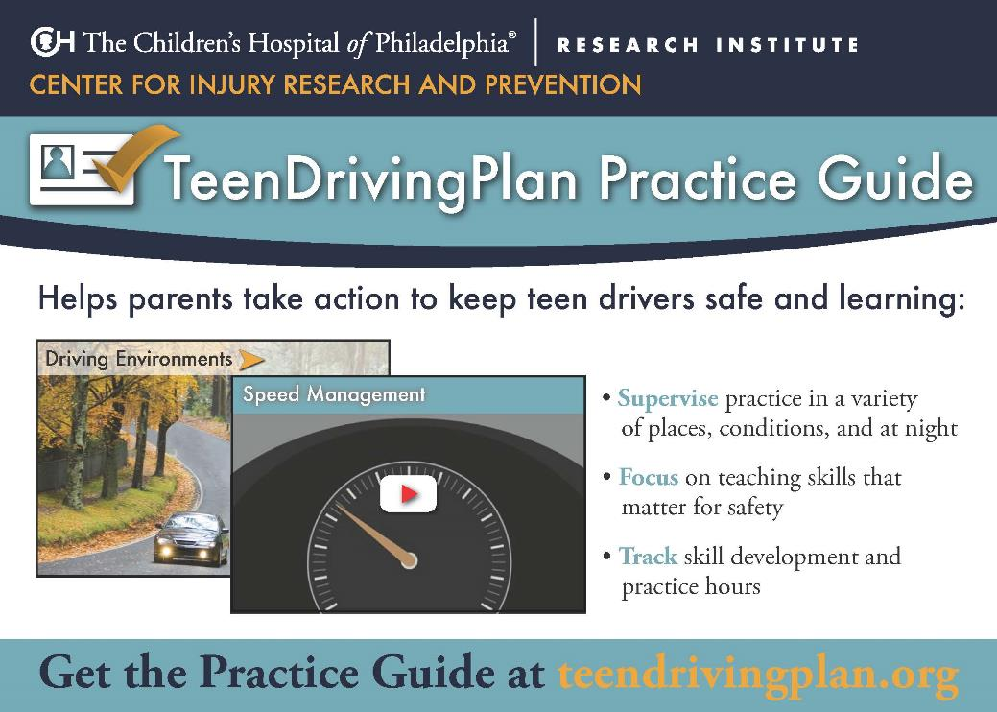
TeenDrivingPlan Practice Guide
This interactive resource is designed to help parents effectively supervise their teen’s driving practice.
The TeenDrivingPlan Parent Guide can be printed to keep in the car or downloaded to an electronic device or desktop.
Notes:
This interactive resource includes information and tools from the TeenDriving Plan Parent Guide and is designed to help parents effectively supervise their teens’ driving practice.
A randomized, controlled trial found that teens with families that followed the TDP program were 65 percent less likely to make dangerous driving errors. These families also increased their variety of practice to boost driving performance.
See more at: https://www.teendriversource.org/tools/for_parents/detail/244/TeenDrivingPlan-Parent-Guide#sthash.QaUoUStS.dpuf

Slide 13
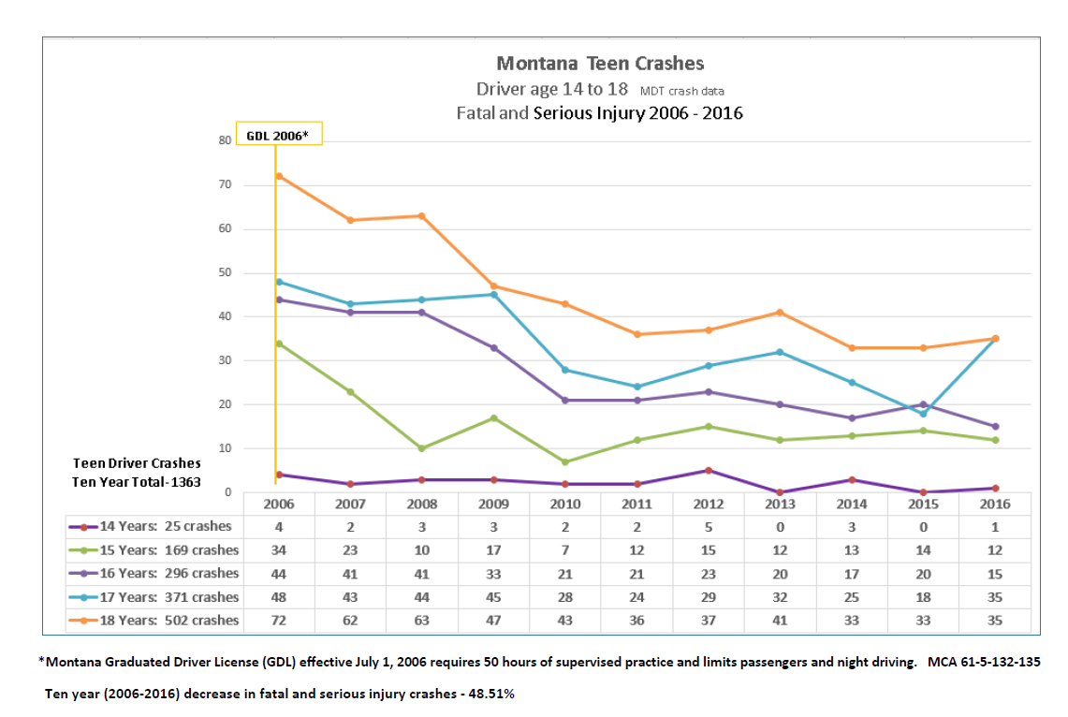
GDL in Montana – reducing teen crashes 48.5%
Notes:
Fatal and serious injuries caused by drivers age 14-18 dramatically decreased
(-48.5%) since the Graduated Driver Licensing law was passed by the Montana Legislature in 2005. The law went into effect in 2006.

Slide 14
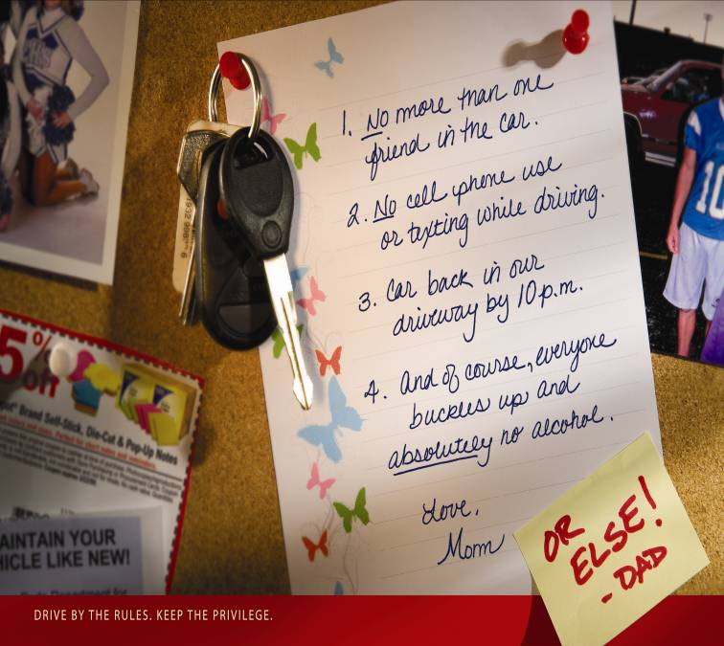
GDL Step 2: First-Year Restricted License
Notes:
Set limits and have family rules that teens understand are about safety, not control.
Montana’s GDL places limits on teens during their crucial first year of solo driving. Agreements between you and your teen are an excellent way to hold your teen accountable while they are beginner drivers. Gradually increase driving privileges as your teen gains skill and competence, and shows responsibility.

Slide 15
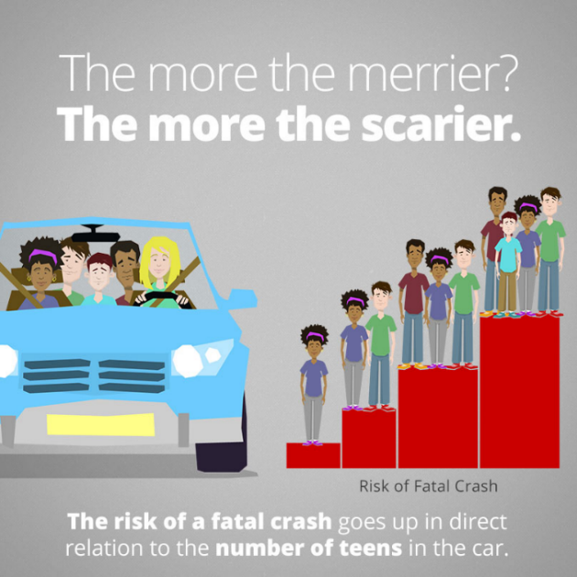
Montana GDL Step 2: Restricted License
FIRST solo license. Valid for one year.
Seatbelts required –
for everyone, all the time.
Passengers are restricted:
First 6 months – only one
Second 6 months – up to three
Best Practice: No passengers.
Night driving is restricted:
11:00 pm – 5:00 am
Best Practice: Drive in daylight when you can. The real risk is darkness.
Notes:
Montana GDL Restrictions:
Seatbelts required – for everyone – all the time.
Passengers – First 6 months – only one who is not a family member
Second 6 months – up to 3 passengers who are not family members
Best Practices: No passengers
Night restrictions – teens can’t drive between 11:00PM and 5:00AM unless it’s an emergency, or you’re travelling to school, church, work or farm activities.
Best Practices: The real risk is darkness.
No traffic tickets, alcohol or drugs.

Slide 16
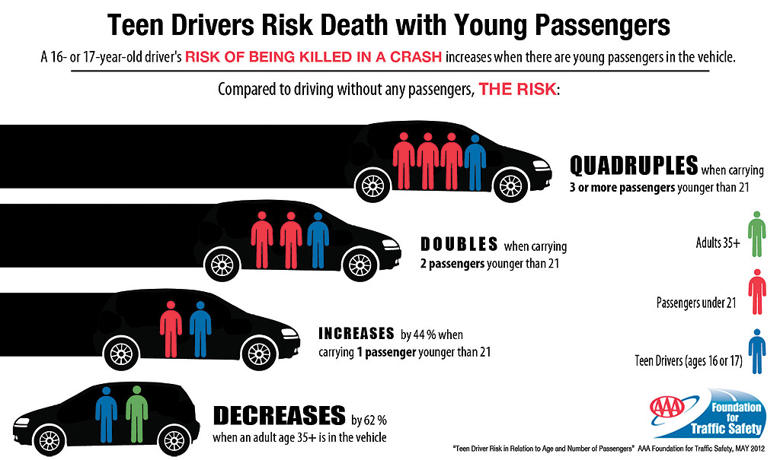
Why are Passengers Restricted for
New Teen Drivers?
Notes:
ONE passenger doubles the risk, THREE or MORE quadruples it.
IIHS – Insurance Institute for Highway Safety Research
Used with permission from AAAFTS

Slide 17
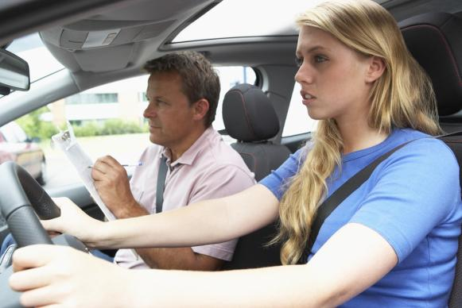
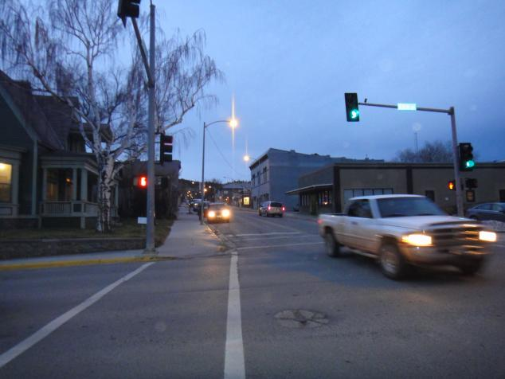
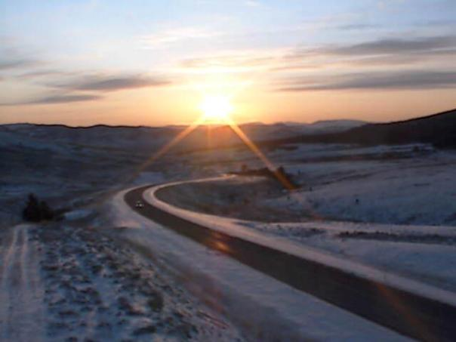
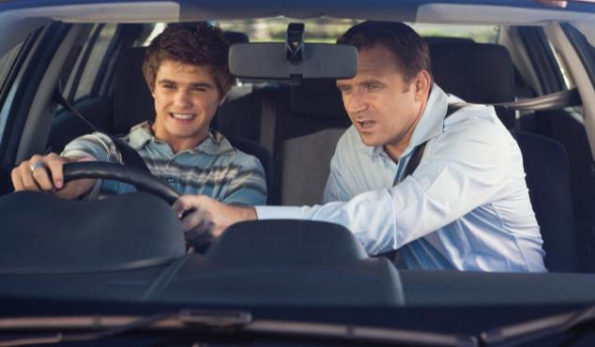
Highest lifetime crash risk is in the first year of independent driving.
Lowest risk is when driving with your parent or guardian.
Notes:
“A teen driver’s greatest lifetime chance of crashing occurs in the first 6 to 12 months after receiving a driver license.” Lowest lifetime crash risk is during supervised learner period.
http://www.chop.edu/healthinfo/teenage-drivers.html
Transition to Unsupervised Driving
“In the early months of unsupervised driving (Step 2 of the GDL), the majority of teens exhibit good driving habits. However, the study did find instances of texting behind the wheel, horseplay with passengers, and running red lights.
While a very small number of instances of deliberate risk‐taking behavior were observed, the vast majority of “close calls” involved judgment errors that seemed to be indicative of inexperience and failure to anticipate changes in the traffic environment. A common scenario involved the teen braking hard after having initially failed to notice that traffic ahead was slowing or stopped.”
2011 AAA Foundation for Traffic Safety Report
Authors: Arthur Goodwin
Robert Foss
Natalie O’Brien
UNC Highway Safety Research Center

Slide 18
Inexperience = More Crashes
Notes:
This 2003 research is old, but the fact remains that driving experience matters. The longer teens drive, the more the risk of a crash drops. It’s clear: crashes drop sharply after 6 months and 1,000 miles of licensure. However, the crash risk among younger drivers remains twice that of adults until age 25.
AAAFTS 2011 Measuring Changes in Teen Crashes During Early Months of Independent Driving
Teen drivers are 50% more likely to crash in the first month of having a license than they are after a full year of experience. Drivers in their first month are nearly twice as likely to crash as they are after two years experience.
57% of crashes in which a teen was partially responsible during the month involved three common mistakes – failure to reduce speed, inattention, and failure to yield.

Slide 19
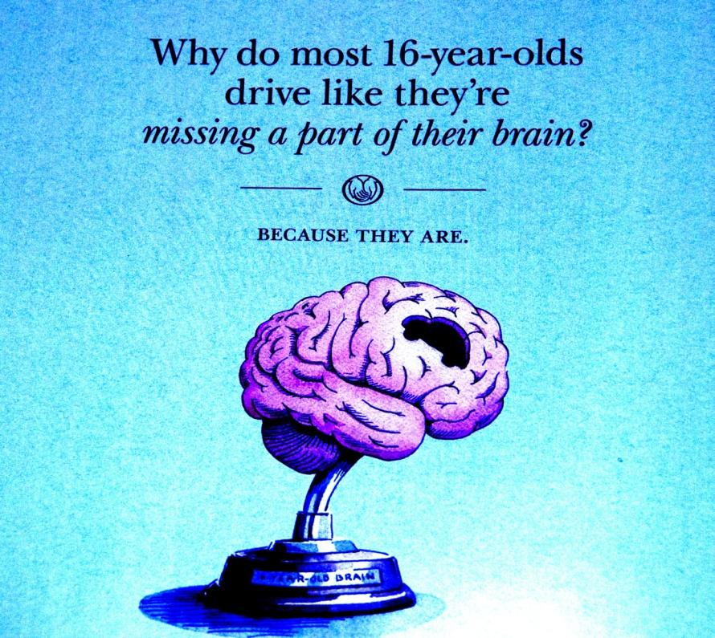
Teens and Judgment
Notes:
This graphic is from an advertisement published by Allstate Insurance:
“Even bright, mature teenagers sometimes do things that are “stupid.”
But when that happens, it’s not really their fault. It’s because their brain hasn’t finished developing. The underdeveloped area is called the dorsal lateral prefrontal cortex. It plays a critical role in decision making, problem solving and understanding future consequences of today’s actions. Problem is, it won’t be fully mature until they’re into their 20s.”
NPR Story: The Teen Brain: It’s Just Not Grown Up Yet (March 2010)
http://www.npr.org/templates/story/story.php?storyId=124119468
Adolescent Brains are a Work in Progress: Here’s Why
Frontline – PBS: http://www.pbs.org/wgbh/pages/frontline/shows/teenbrain/work/adolescent.html

Slide 20

Can I borrow the car?
The conversation starter that might keep a teen from crashing.
Sharing the car gives parents the opportunity to:
review house rules,
help with trip decisions,
provide support on peer pressure.
Notes:
Involved parents who set rules and monitor their teens' driving behavior in a supportive way can lower their teens' crash risk by half. Teens who perceive their parents as acting in this way are:
twice as likely to wear seat belts
70 percent less likely to drink and drive
half as likely to speed
30 percent less likely to use a cell phone while driving
significantly less likely to drive with multiple passengers.
See more about why parents matter at: http://www.teendriversource.org/more_pages/page/why_parents_matter/support_parents#sthash.wsuDgRfJ.dpuf
20

Slide 21
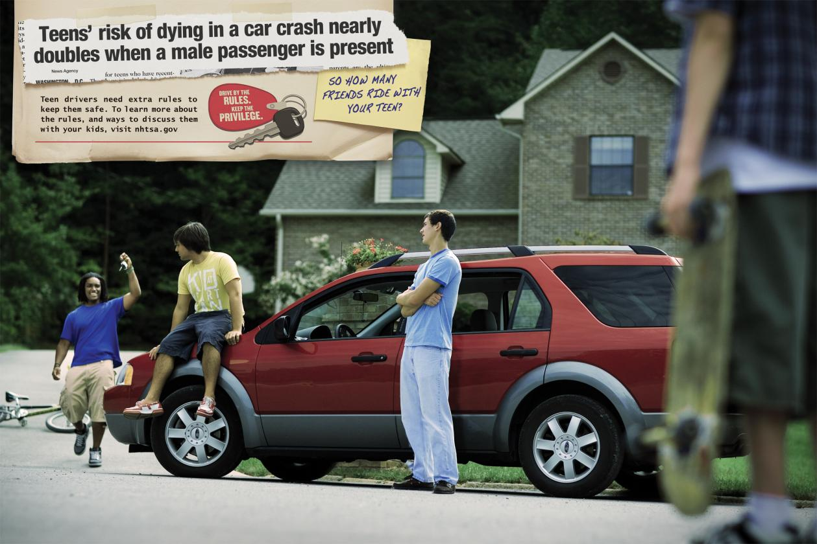
Teen asks Parent:
Can I ride with a friend?
Notes:
Your teen asks: Can I ride with a friend? How do you answer?
Teens’ risk of dying in a car crash nearly doubles when passengers are present.
Teen drivers need extra rules and monitoring by parents or guardians to keep them safe. Don’t hesitate to ask who is driving and how much experience they have. Know where they are going and when they’re coming back.
Driving is not a RIGHT, it is a PRIVILEGE.
Drive by the rules, keep the privilege.

Slide 22
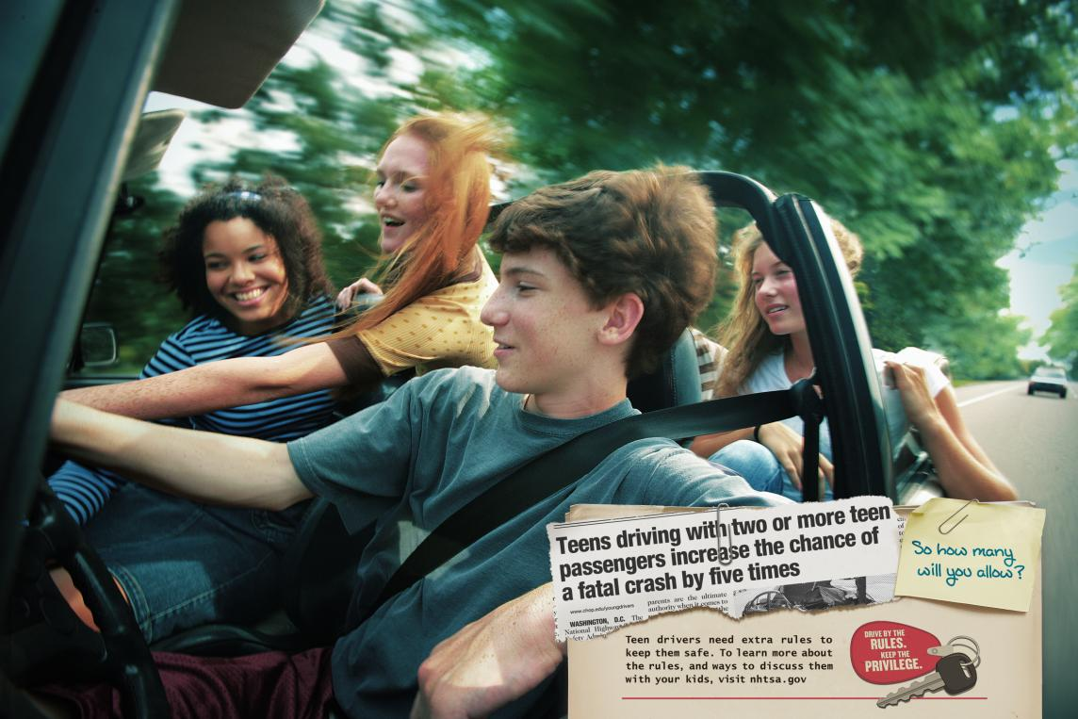
Parent replies:
Is your friend a safe driver?
Don’t let your teen be the passenger that distracts an inexperienced teen driver.
Notes:
The IIHS nationwide fatal crash study of 13-15 year old passengers and drivers during 2005 - 2009 “found 37 percent of the passenger deaths of 13 year olds happened when a teen was driving. This compares with 54 percent at age 14 and 66 percent at age 15.”
Insurance Institute for Highway Safety (IIHS) Status Report Vol. 47, No. 2 March 6, 2012
2012 “Motor vehicle fatal crash profiles of 13 – 15 year olds” by A.F. Williams and J.T. Tison

Slide 23
Practice Pointers
For supervising parents, guardians,
and other supervising adults
The following slides are examples of lessons your student driver will learn.
Your teen’s teacher will share with you other resources and guides to help your teen successfully meet the goals of this course, and help you supervise your teen driver during Step 1 of the GDL process.
Notes:
The following slides are examples of lessons your student driver will learn.
Your teen’s teacher will share with you other resources and guides to help your teen successfully meet the goals of this course, and help you supervise your teen driver during Step 1 of the GDL process.

Slide 24
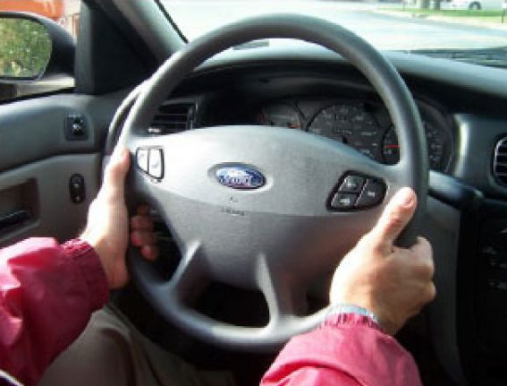
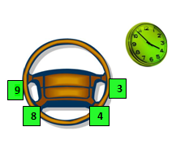
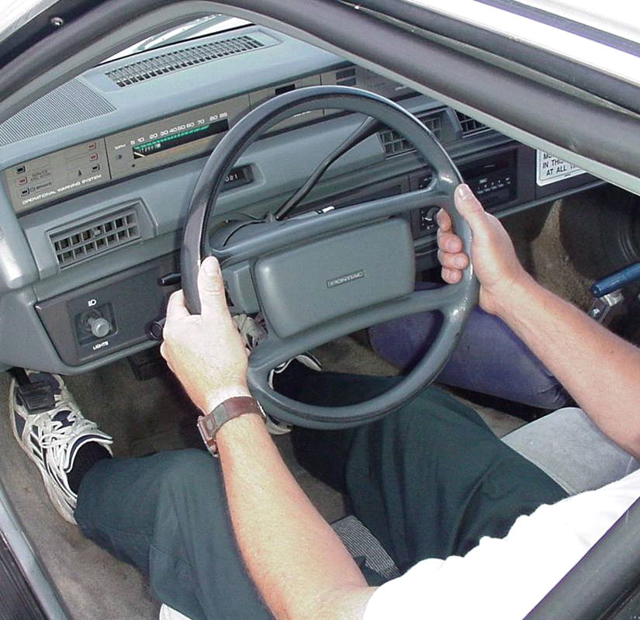
Steering for Balance and Control
Proper hand position is at 9 and 3 or 8 and 4.
Why?
Air bags and power steering. This hand position keeps arms out of the way.
Notes:
Proper hand position is at 9 and 3 or 8 and 4.
Why this position?
Air bags and power steering. New position keeps arms out of the way.
Photo: American Driver and Traffic Safety Education Association

Slide 25
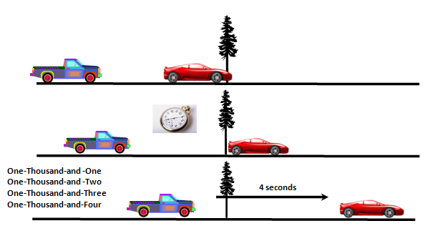
Minimum Following Distance
Or … how not to be a tailgater
Drivers have the most control over the space directly in front of the vehicle.
Notes:
Drivers have the most control over the space directly in front of the vehicle.
Three-second following distance
May be enough time to steer away from a problem on dry surfaces or brake at speeds up to 45 mph
Four-second following distance
Provides time to steer out of a problem on dry surfaces and brake out of a problem at speeds up to 80 mph (the speed limit on many of our highways now)

Slide 26

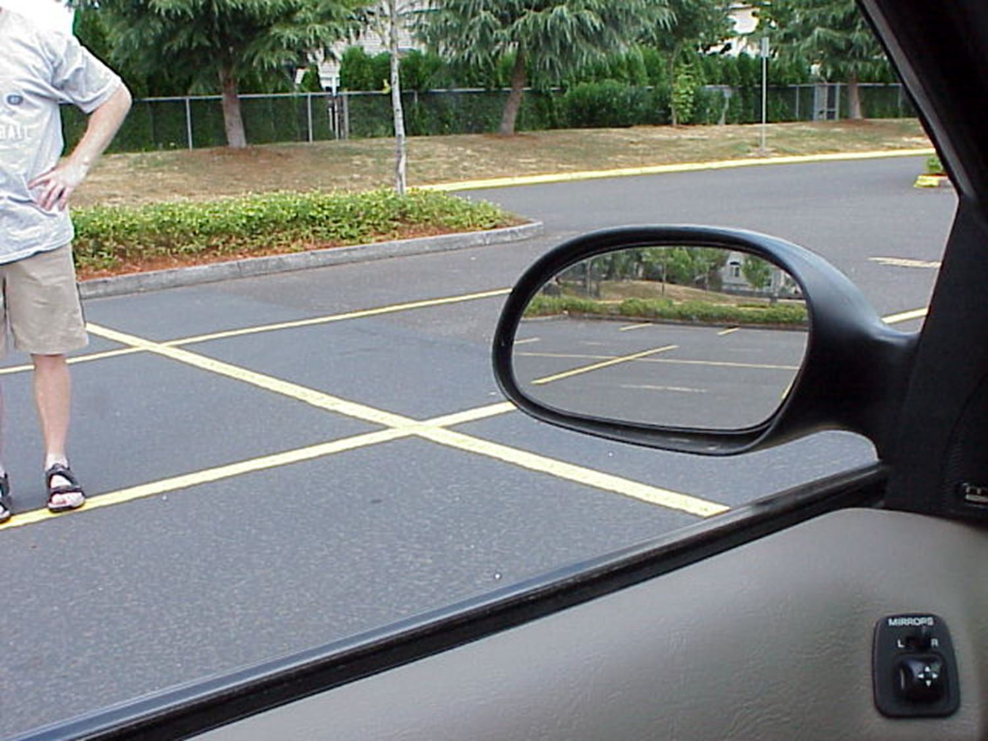
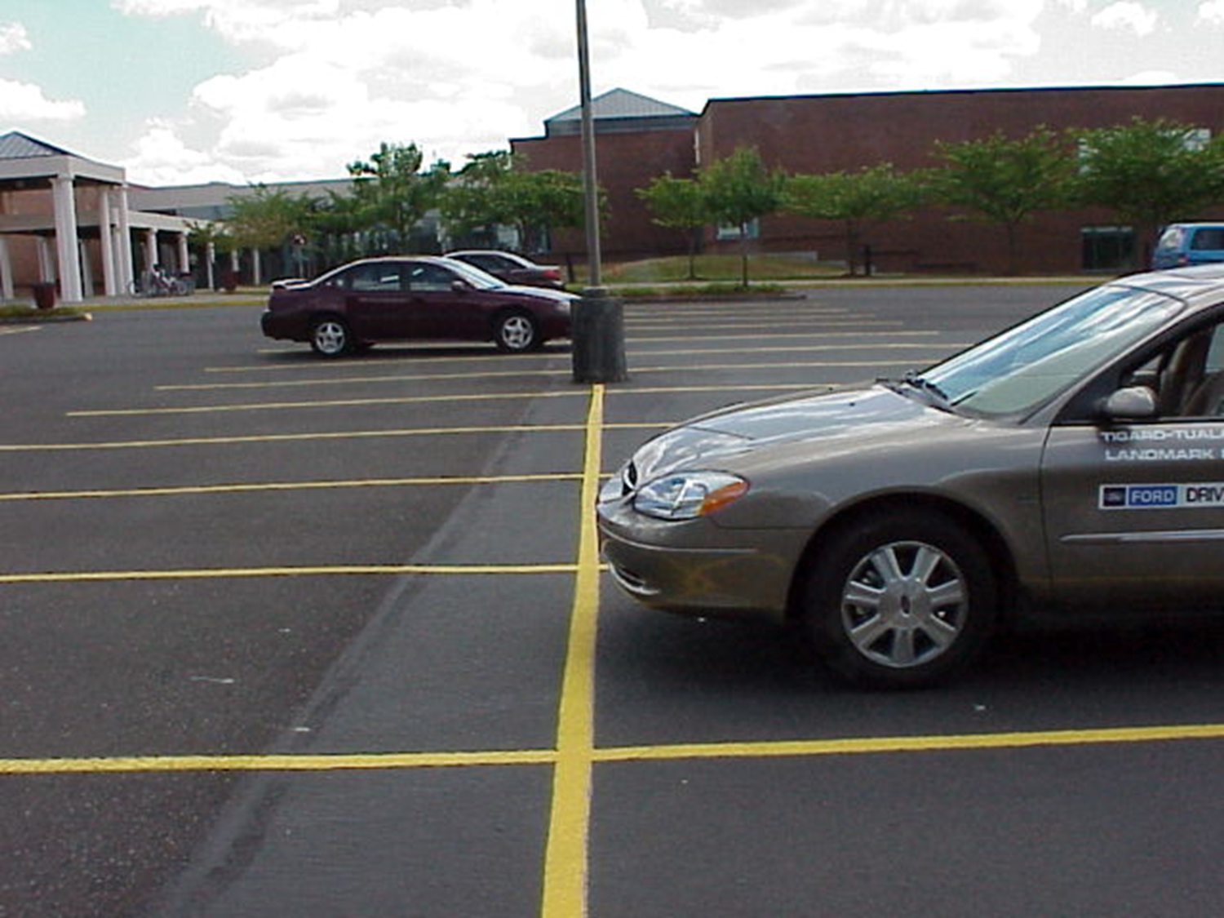
Reference Points
Managing the space around your vehicle:
at intersections
in a stopped position
perpendicular parking
Front Limitation
Front Limitation
Notes:
A reference point is seeing some part of the vehicle as it relates to the roadway. This helps the driver know precisely how far the vehicle is from other objects or where the vehicle is in relation to the road.
Knowing reference points can help with parking (especially parallel parking), backing, moving to the left and right in traffic, and stopping precisely at a crosswalk or stop line.
This skill aids vehicle control and managing the space around your vehicle.

Slide 27
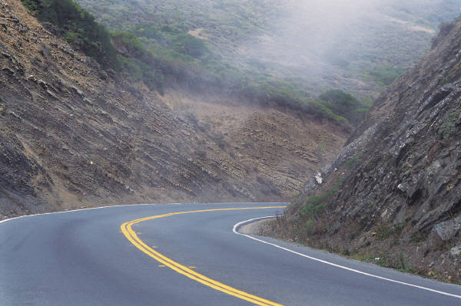
LOS-POT
Line of Sight - Path of Travel Blockages
What you can’t see can hurt you.
A safe driver knows to slow down at this curve, not pass slower vehicles, and wait to see what’s around the bend before speeding up.
Notes:
Not anticipating curves and slowing down is a frequent cause of crashes. Used in driver education, LOS-POT increases awareness of anything that obstructs a view (LOS) of the road ahead such as another car, fence, house, hedge, and anything in the path (POT) or near the path that blocks ability to drive there.

Slide 28
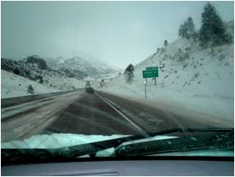
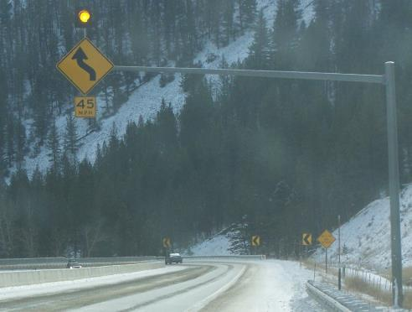
Targeting
Find • Solve • Control
FIND: Finding what is relevant.
LOS and POT blockages.
SOLVE: Deciding my options to create more space and time.
Checking related zones before acting.
CONTROL: Putting my decisions into action.
Lane position, speed control, communication.
Notes:
FIND: Finding what is relevant
LOS and POT Blockages
SOLVE: Deciding my options to create more space and time
Checking related zones before acting
CONTROL: Putting my decisions into action Lane position, speed control, communication

Slide 29
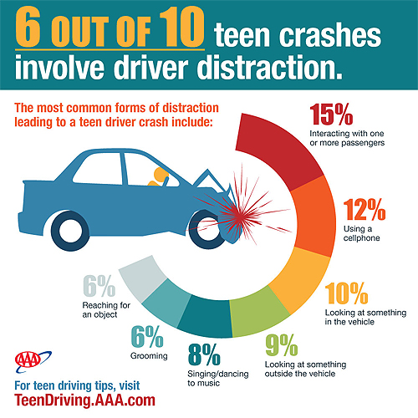
Distractions are Often Deadly
Notes:
Six out of ten teen crashes – 60 percent – involve driver distraction:
15% Passengers
12% Using a cellphone
9-10% Eyes off road, looking elsewhere
6-8% Reaching for object, grooming, singing/dancing to music

Slide 30
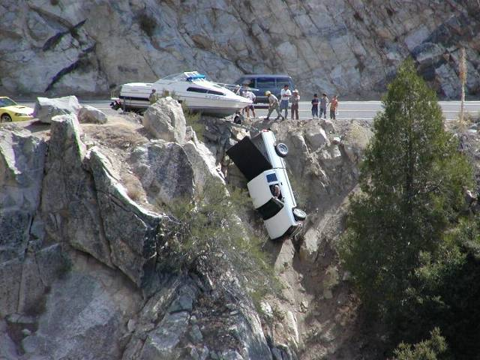
Attentive Driving is Defensive Driving
Visual - Eyes
on the road
Cognitive - Mind on driving and active scanning for hazards
Manual - Hands on the steering wheel
Notes:
Attentive driving is defensive driving to protect against safety threats in the driving environment including other drivers, deer, blind curves and intersections.
Situational Awareness
Perception: what information do I need?
Comprehension: what does it mean?
Projection: what will happened next?
Source: Situational Awareness and it’s relationship for Driving Safety
Jay A. Winsten, Ph.D. Harvard T.H. Chan School of Public Health http://lifesaversconference.org/wp-content/uploads/2017/03/WinstenJ.pdf
Nearly 8 out of 10 crashes happen within three seconds of a driver becoming distracted.

Slide 31
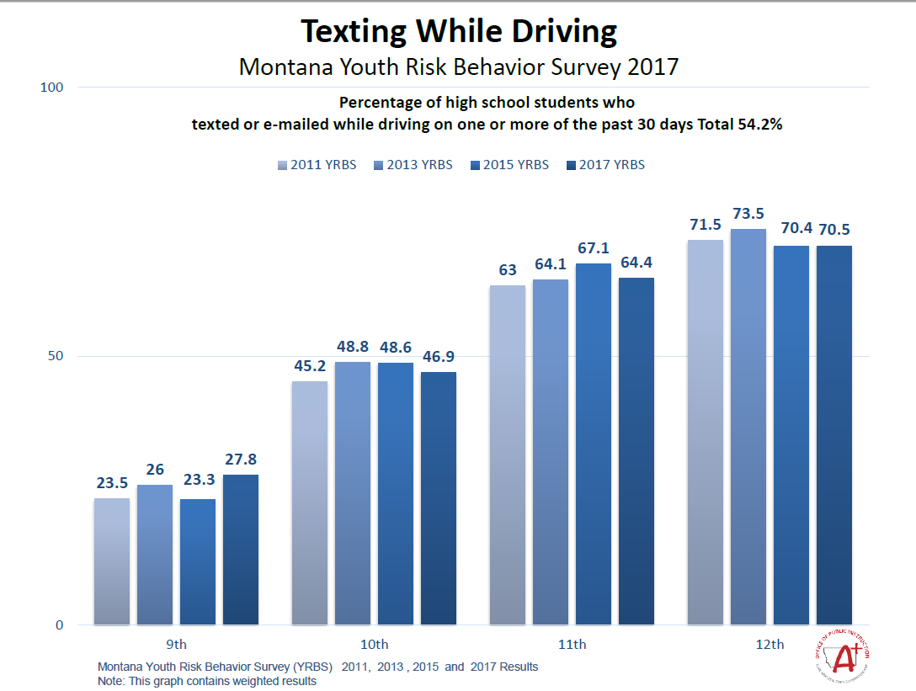
Notes:
Montana Youth Risk Behavior Survey

Slide 32









How many distractions are too many?
Notes:
Why is distracted driving dangerous? What other distractions take your focus off the driving task?
Distraction occurs any time you take your eyes off the road, your hands off the wheel, and your mind off your primary task: driving safely. Any non-driving activity you engage in is a potential distraction and increases your risk of crashing.
Courtesy of http://www.distraction.gov
Photos from MS clip art March 2014

Slide 33
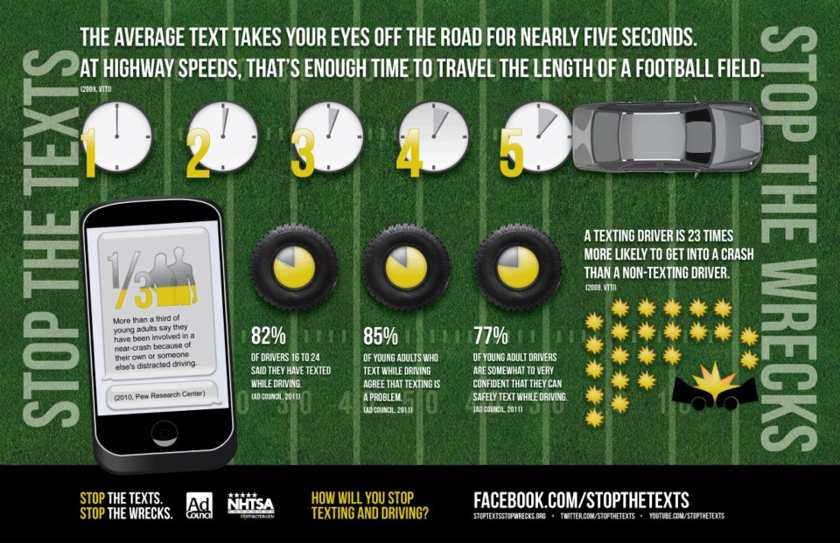
Notes:
Stoptextsstopwrecks.org
Facebook: stopthetexts

Slide 34
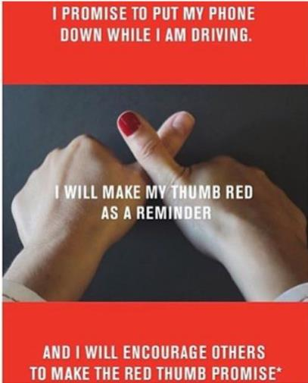
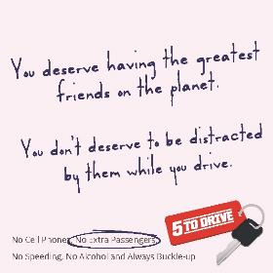
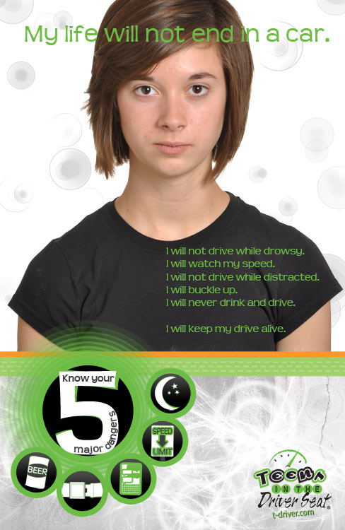
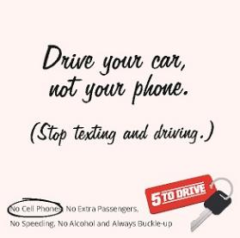
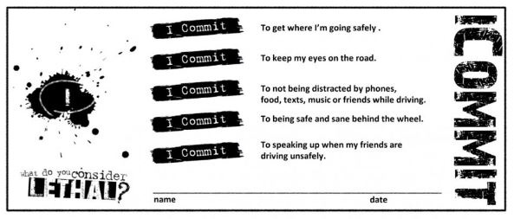
Encourage safe driving at home and school
http://impactteendrivers.org/resources/tools/icommit-cards
Notes:
RedThumbReminders.comDistractions.gov
TeenDriverSource.org
ImpactTeenDrivers.org
More resources for teens and parents at http://www.opi.mt.gov/Programs/DriverEd

Slide 35
Traffic Education Program Policies
      Class schedule
      Attendance
      Behind-the-Wheel (BTW) scheduling
      Driving to traffic education class
      Classroom make-up sessions
      BTW make-up sessions
      Tardiness and absences
      Drive groups
      Successful Completion
      Other
Notes:
State Traffic Education Program Requirements: ARM 10.307-308
25 contact days for each student
60 hours – with minimum of 6 hours behind the wheel in-traffic driving instruction scheduled over no less than six student contact days

Slide 36
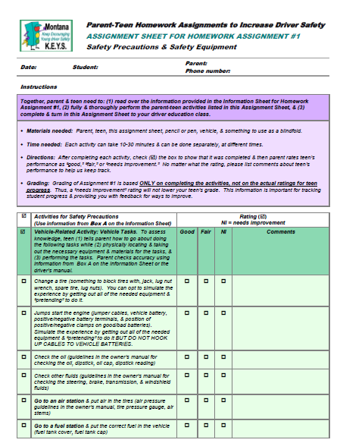
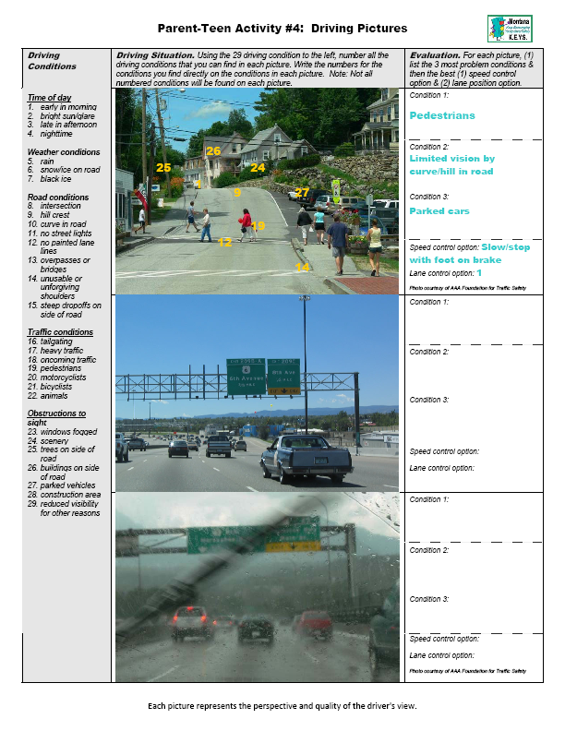
Montana KEYS
Parent Teen Homework
Notes:
Sample KEYS Parent and Teen homework
2009

Slide 37
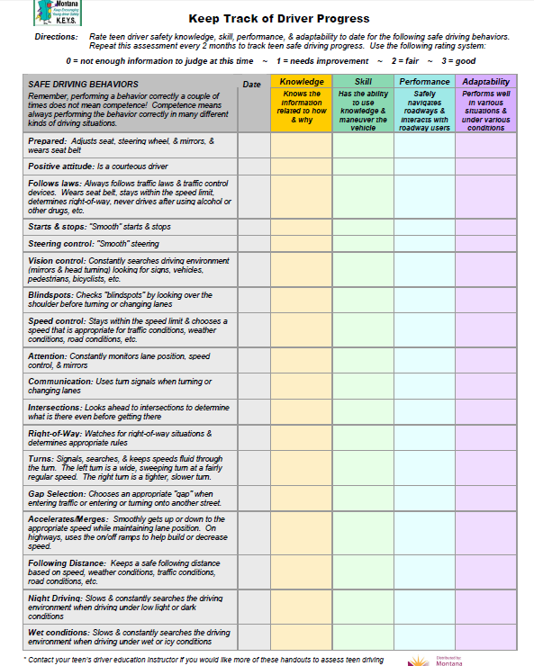
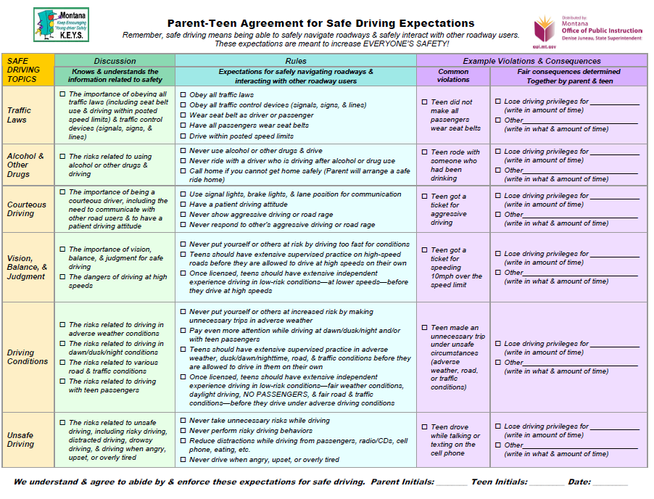
Montana KEYS Skill Assessment and Parent Teen Agreement
Download the KEYS packet at: http://opi.mt.gov/curriculum
Notes:
Skills Assessment KEYS Project 2009
http://opi.mt.gov/Digital-Asset-Manager?folderId=45295&view=gridview&pageSize=2147483647

Slide 38



Getting Your Montana Driver’s License
Traffic Education Permit (TEP)
To drive only with instructor
After GDL 50 hours
and 6 months
of supervised driving practice and NO alcohol, drug or traffic violations
Notes:
One of the incentives for teens to enroll in driver education is to qualify for a driver license before age 16. Parents value the professional instruction and guided practice to help their teens develop safe driving skills and habits.
Generally teachers cover the first few modules on Preparing to Drive, Basic Control and Traffic Laws before administering the CDTP tests.
Students must be age 14.5 and participating in traffic education to be eligible to take the DOJ/MVD Knowledge test and receive a Traffic Education Learner’s License.
Passing the Knowledge Test could create the illusion that teens know how to drive even though the MT Driver Manual includes:
“SECTION 6 - SAFE DRIVING TIPS
No manual can teach you how to operate a vehicle or be a safe driver. Driving requires skill you can only gain through instruction and practice, and even then it all depends on how you choose to apply what you have learned.”

Slide 39

The Driver License Application
Parent/legal guardian must fill out and sign the 3-page driver license application and agree to assume financial and legal liability for damages or losses. Must be notarized if not signed in presence of instructor.
Bring in certified birth certificate, piece of mail with student’s name/physical address, Social Security card, and eyeglasses/ contacts, if needed, for vision test.
Student MUST be at least 14.5 on the day the Knowledge Exam is given to receive a Learner License while enrolled in traffic education.
The Cooperative Driver Testing Program (CDTP) allows a trained and certified driver education instructor to administer the written exam and road test to students taking driver education.
Notes:
Most school districts in Montana participate in the Cooperative Driver Testing Program (CDTP), which allows a trained and certified driver education instructor to administer the written exam and road test to students taking driver education.
To participate in the program and allow teen to receive a learner license as part of the driver education course, parents or guardians must fill out a driver license application and provide the same documentation to the school district that they would bring to the driver exam station.

Slide 40
Plan ahead for the GDL Restricted License
Make your appointment EARLY to get the day and time you want.
Find your Driver Exam Station
ON THE INTERNET:
http://www.dojmt.gov/driving
ON THE PHONE:
1 (866) 450-8034
MAKE AN APPOINTMENT SO YOU WON’T HAVE TO TAKE A NUMBER & WAIT IN LINE.
Don’t wait … visit the Appointment Scheduling site at:
https://dojmt.gov/driving/appointments/
Select Testing “Driver Ed” and then one of three choices depending on your situation:
Driver Ed Written Test – teen needs a learner license.
Driver Ed Road Test – teen wasn’t waived on road test and needs to take the road test.
Driver Ed Waived – teen was waived on all tests during driver ed (but might get chosen at random to take the road test again.)
You can also call the MVD Customer Care Center at (406) 444-3933 or toll-free (866) 450-8034.
Driver exam stations REQUIRE scheduled appointments for written and road tests.
Notes:
Make an appointment EARLY, either online or by phone where required
When scheduling your appointment, fill out the online form in Driver Ed section. 10% of students will be chosen to take the road test again.

Slide 41
At the Driver Exam Station …
Arrive on time! If you took driver’s education and the road test was given and you were waived, you might be one of the 10% selected randomly to take the test again.
Bring with you:
CERTIFIED BIRTH CERTIFICATE (not a copy)
SOCIAL SECURITY CARD (not a copy)
Cancelled piece of MAIL showing your name and Montana residence address (not a PO Box)
Eyeglasses if you need them.
Parent/legal guardian to SIGN CONSENT
Driving practice LOG showing hours driven
Driver License Exam Stations require TWO forms of identification.
The list of additional documents which are accepted can be found at https://dojmt.gov/driving/
Notes:
This is a good slide to print out and keep handy for the day you go to the Driver Exam Station to get your restricted license.
Be prepared to pay the fee.
Visit https://dojmt.gov/driving/ for more info.

Slide 42

From a Belt Up PSA for Road Safety Commission of Western Australia

Slide 43

“You’ve invested time and caring to grow them well and keep them healthy and safe.
Your time and caring are needed now
more than ever.”
David Huff, Traffic Education Director – 1992 - 2011
Montana Office of Public Instruction
Notes:
David Huff
Traffic Education Director – 1992-2011
Montana Office of Public Instruction

